Slide 1
Inventory Optimization and Demand Forecasting
Using Machine Learning and Deep Learning Methods
Randy Otoo

Slide 2
Introduction
Managing inventory effectively and accurately predicting demand are essential for running a business efficiently and increasing profits.

Slide 3
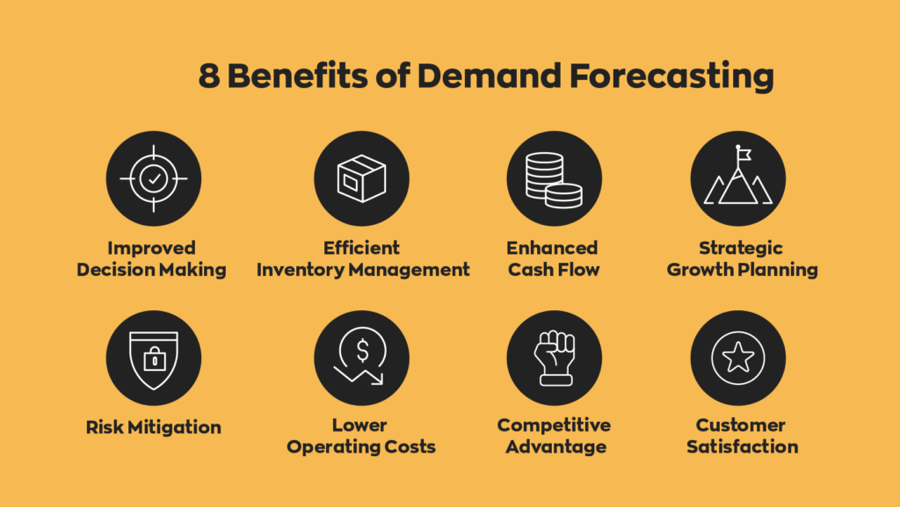

Slide 4
Goal of the Project
To develop a predictive model that optimizes inventory management by accurately forecasting demand using Machine Learning and Deep Learning techniques.

Slide 5
Data Description
Data Source : retail inventory from Kaggle
73,100 Observations and 15 variables
Features : Date, Category, Inventory Level, Units Ordered, Demand Forecast, Price
Target = Units Sold
Data Preprocessing
Date Format
Handled Missing values
Normalized(Units Sold for LSTM)
Created sequence for LSTM
Data Split
Training Set 80%
Test Set
20

Slide 6
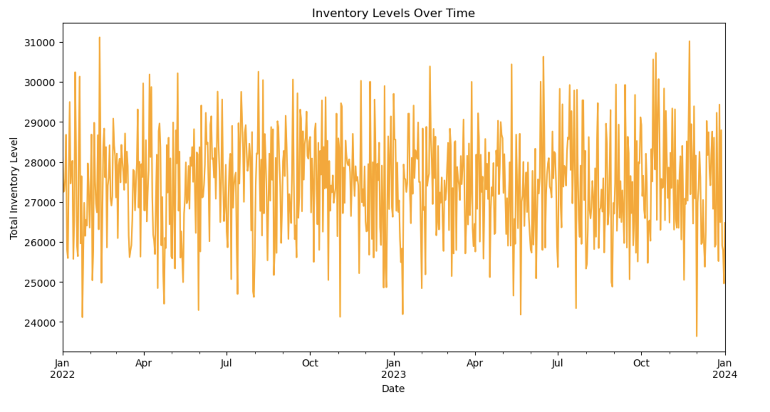
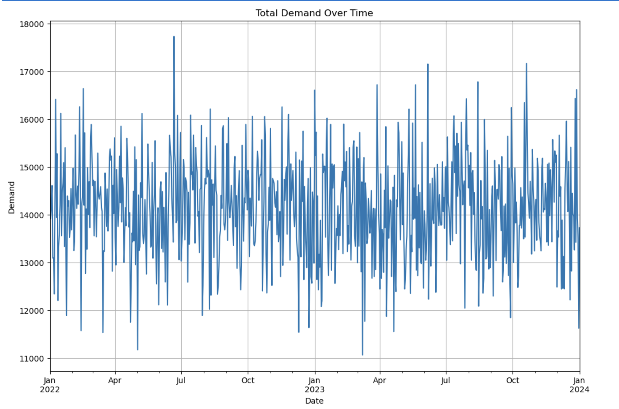
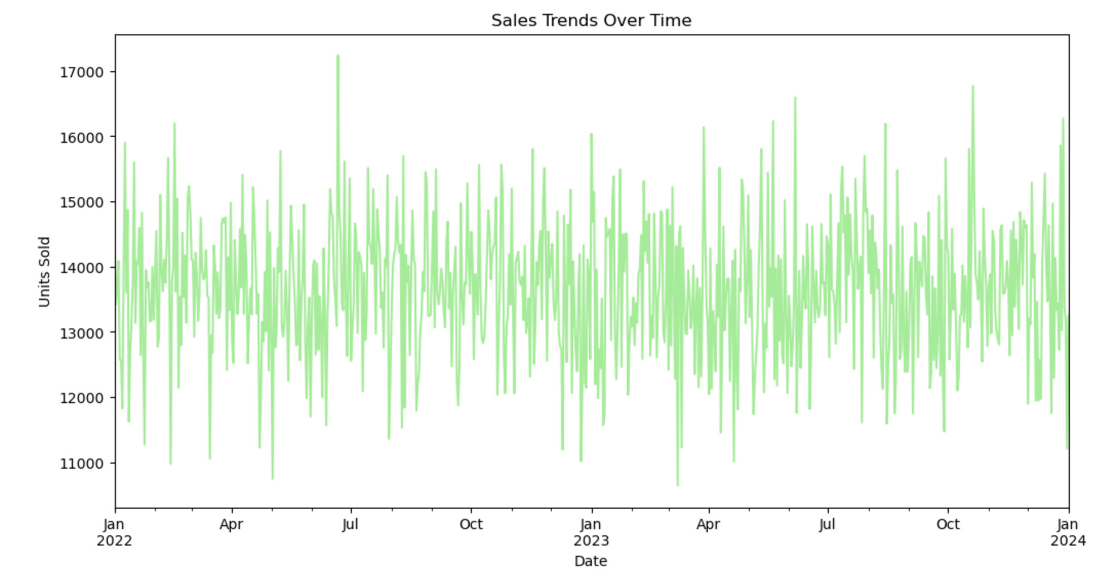
Exploratory Data Analysis

Slide 7
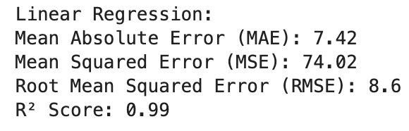
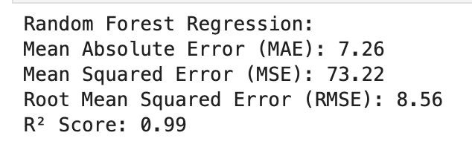
Machine Learning Models(Base Models)
Linear Regression
Random Forest

Slide 8
Times Series Model (ARIMA)
ARIMA Model: Times series forecasting method for stationary time series data that combines ;
AutoRegression(AR): Use its lagged observations to predict the current values.
Integration(I): Helps removes trends to make the times series stationary(constant mean and variance).
Moving Average (MA) : model residual errors and used to predict future values.

Slide 9
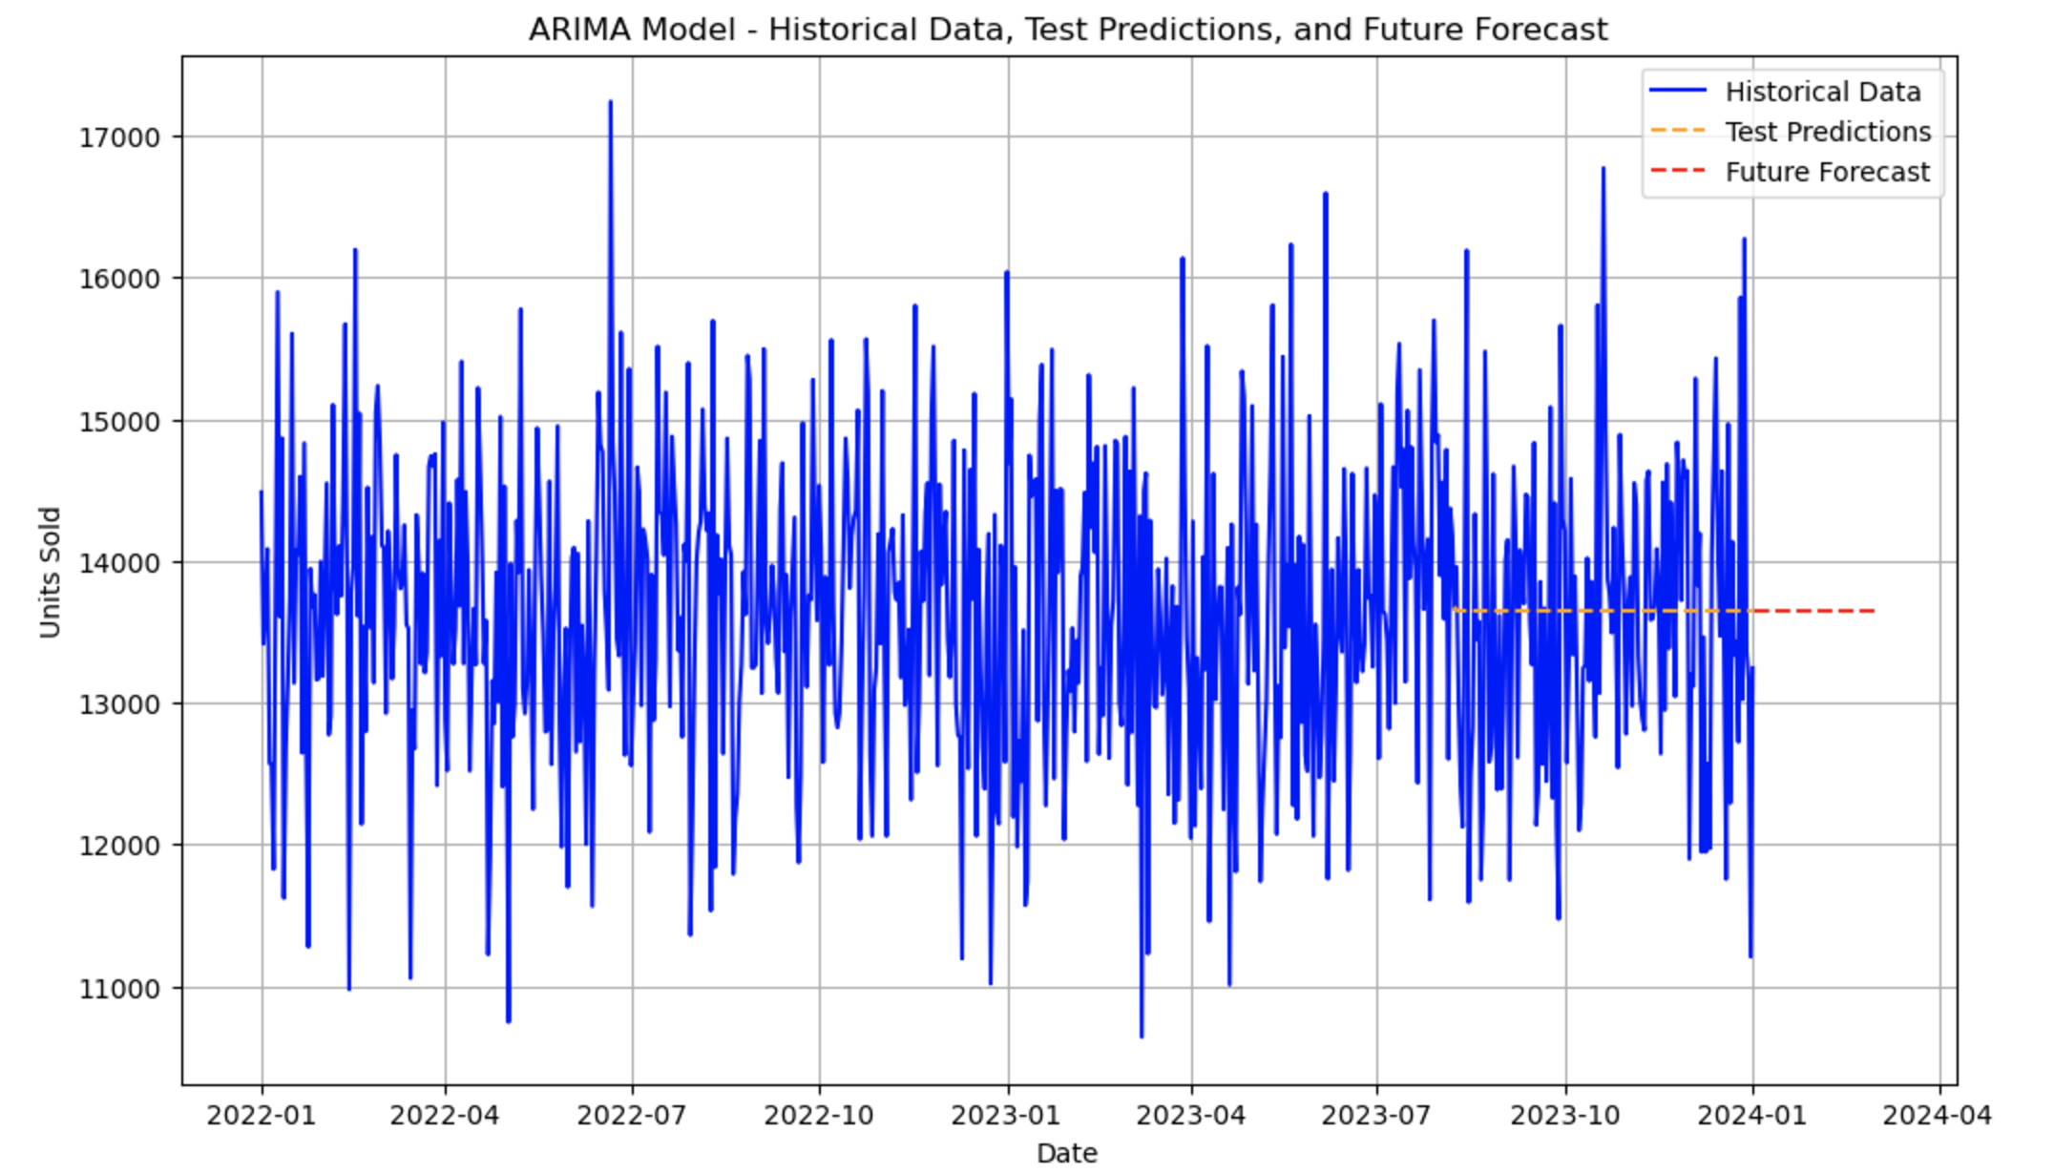
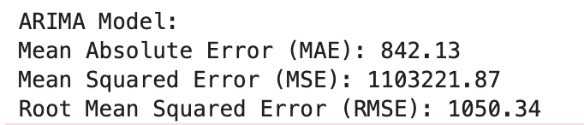
Times Series Models(ARIMA)

Slide 10
Deep Learning Model(LSTM)
Long Short-Term Memory (LSTM):- Specialized for time-series data
Captures temporal dependencies
Handles seasonality and trends
Adapts to changing data patterns

Slide 11
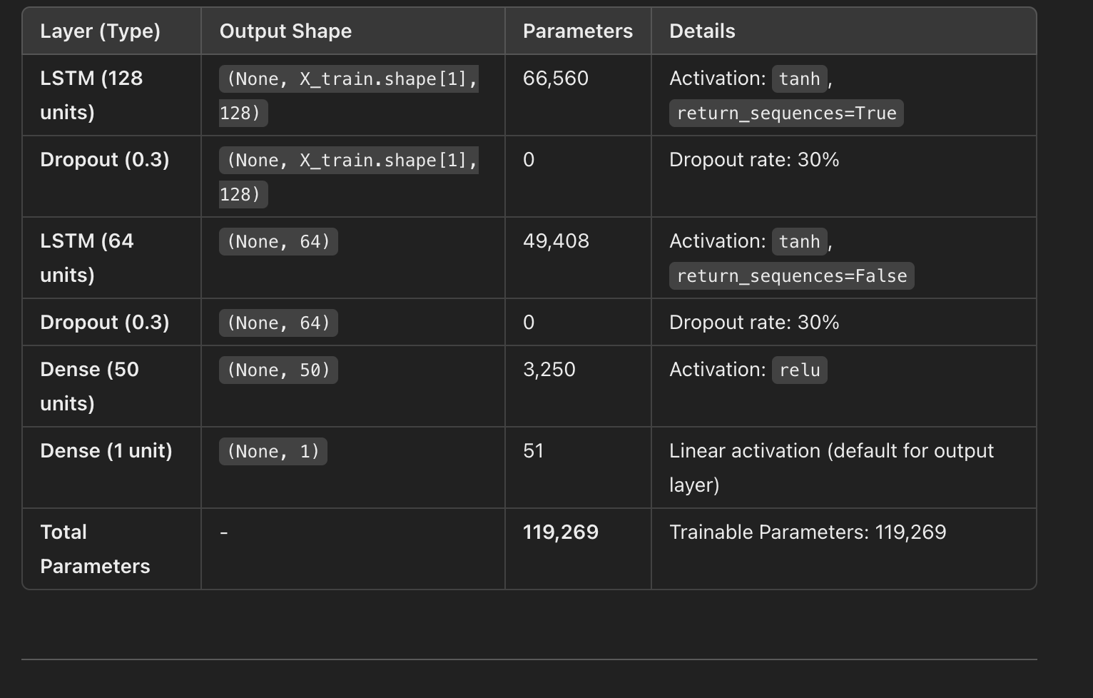
Model Architecture (LSTM)

Slide 12
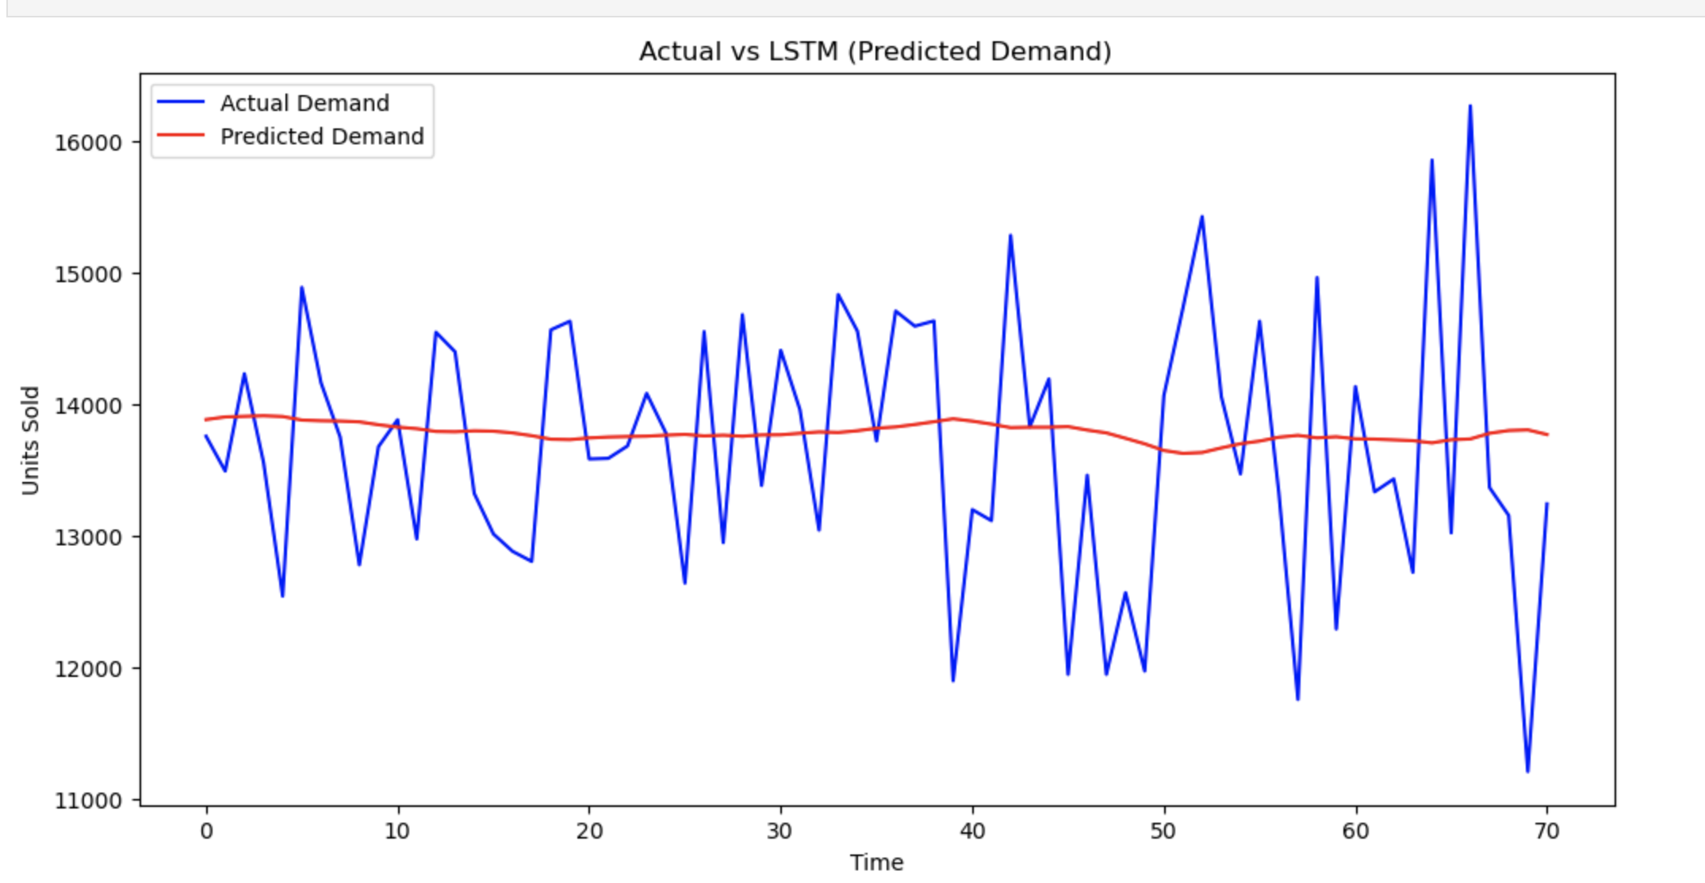
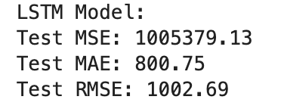
LSTM Demand Forecasting

Slide 13
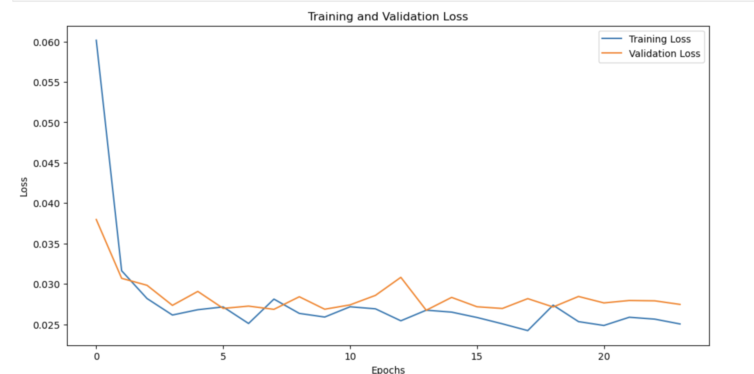
LSTM

Slide 14
Compare models using evaluation metrics

Slide 15
Business Impact
Reduced inventory costs
Improved demand prediction accuracy
Enhanced decision-making
Future Work:
Optimize Hyperparameters: Use grid search or random search to find the optimal hyperparameters such as the number of layers, neurons per layer, learning rate etc
Incorporate Additional Features: Include more features such as holiday effects, promotional events, weather conditions.
External Data Sources: Integrate external data such as macroeconomic indicators, market trends, and social media sentiment to enrich the model's input.

